Slide 1

Capstone Project Review
Title: AI-Driven Insights for Stock Market Forecasting
GUIDE NAME :
Smruti Rekha Das
Dept. Of CSE

Slide 2
TEAM
S.NO | Names | Reg. No
1 | D.Dheeraj Kumar | VU21CSEN0101004
2 | SMN Rishitha Varma | VU21CSEN0101013
3 | Venu Harsha | VU21CSEN0101412
4 | S. Ramesh Naidu | VU21CSEN0101470

Slide 3


Contents
1. Abstract
2. Introduction
3. Literature Review
4. Requirement Analysis
5. Design Analysis
6. Methodology/ Tools/Methods to be used
7. Implementation
8. Screenshots of the project
9. Results & Discussions
10. Conclusion and Future Scope
11. References
CSE, GST, Visakhapatnam

Slide 4
Abstract
This research work is based on the collection of Reliance stock market data for supervised learning to train and predict, considering technical indicators such as moving averages, RSI etc. A Hybrid model based on Extreme Learning Machines (ELM), and Artificial Bee Colony (ABC) optimization algorithm is experimented and compared with some of the widely accepted model in stock market. The performance of the proposed model is measured by evaluation metrics such as Mean absolute error (MAE), Mean squared error (MSE), Root mean squared error (RMSE), and R-squared. The research intends to provide a robust predictive model to yield accurate and reliable forecasts through hyperparameter tuning. The results show the prosed model outperform over SLFN and ELM.

Slide 5
Introduction
What is the Stock Market?
The stock market is a marketplace where investors buy and sell shares of publicly listed companies. It plays a crucial role in the economy by providing a platform for companies to raise capital and investors to trade securities. Stock prices fluctuate based on supply and demand, company performance, and broader economic factors.

Slide 6
Introduction
What is the purpose of using AI in stock marketing?
The purpose of using AI in stock marketing is to make better investment decisions by analyzing large amounts of data quickly and accurately. AI helps predict stock price movements, identify trends, and detect risks based on past market patterns. It automates trading, reduces human errors, and improves decision-making by providing insights that humans might miss. This saves time, increases efficiency, and helps traders and investors make smarter choices in the stock market.

Slide 7
Problem Statement
The stock market is always changing, with prices going up and down due to factors like supply and demand, company performance, and the economy.
Investors want to predict these changes to make smart decisions and earn profits. Traditional methods often fail because stock prices are highly unpredictable.
This project aims to use AI to study past stock data, calculate important market indicators, and apply machine learning models to find the best way to predict stock prices accurately.

Slide 8
Literature Review
 | Title | Year Of Publication & Authors | Technologies/ Methodologies | Result | Limitations
1 | Stock Market Prediction using Natural Language Processing – A Survey | 2022 Om Mane, Saravanakumar Kandasamy | Natural Language Processing (NLP), Machine Learning | Used NLP and ML to analyze stock trends, highlighting research trends without specific models or results | Specific predictive models or empirical results were not provided.
2 | Effectiveness of Artificial Intelligence in Stock Market Prediction based on Machine Learning | 2021 Sohrab Mokhtari, Kang K. Yen, Jin Liu | Machine Learning (Regression and Classification Algorithms) | Used regression and classification ML for analysis, showing median performance, suggesting AI may not outperform the market. | Concluded that it's premature to claim AI can consistently beat the stock markets with current technology.
3 | Empirical validation of ELM trained neural networks for financial modelling | 2022 Christopher Bilson, Geoff Harris | Machine Learning (ELM and Recurrent Neural network) | ELM models surpassed LSTM in accuracy and training speed, enhancing real-time efficiency | ELM struggled with stocks experiencing significant data distribution changes, where LSTM performed slightly better

Slide 9
Literature Review
 | Title | Year Of Publication & Authors | Technologies/ Methodologies | Result | Limitations
4 | A Quick Gbest Guided Artificial Bee Colony Algorithm for Stock Market Prices Prediction | 2018 Habib Shah, Harish Garg, Nasser Tairan | Artificial Bee Colony(ABC), FFNN (Feedforward Neural Network) | Achieved fast convergence, high accuracy, and better SSM price prediction than traditional ABC methods | Risk of getting trapped in local minima; limited by the quality of historical stock data..
5 | Stock Market Prediction using different Machine Learning Algorithms | 2023 Vidushi Tiwari, Bhanu Prakash Lohani, Ajay Rana, Upendra Pratap Pandey | SVM, Random Forest, LSTM, Decision Trees, Neural Networks | Random Forest led in short-term accuracy, while SVM topped the F-score across all time horizons | Models rely solely on historical price data without considering external factors (news, social media, events).
6 | ELM-Based AFL–SLFN Modeling and Multiscale Model-Modification Strategy for Online Prediction | 2019 XiaoliWang, He Zhang, Yalin Wang and Shaoming Yang | ELM, SLFN, AFL (activation function learning), hybrid modeling | Boosted accuracy with dynamic learning and adaptive weights. | SLFNs' simultaneous training increases computational cost, impacting real-time use..

Slide 10
Requirement Analysis:
Data Requirements:
Historical Stock Market Data: Collect reliable stock price data, including opening and closing prices, volume, and dates.
Data Processing Tools: Software like Excel or Python for organizing data, calculating moving averages, returns, and volatility.
Model Requirements:
Prediction Models: Implement SLFN, ELM, and ELM with ABC to assess each model’s accuracy and error rates.
Functional Requirements:
1. Data Cleaning and Preprocessing: Capability to clean, structure, and normalize the raw data, possibly in Excel.
2.Technical Indicators: Moving averages, volatility, Relative Strength Index (RSI), etc., calculated from the
historical data.

Slide 11
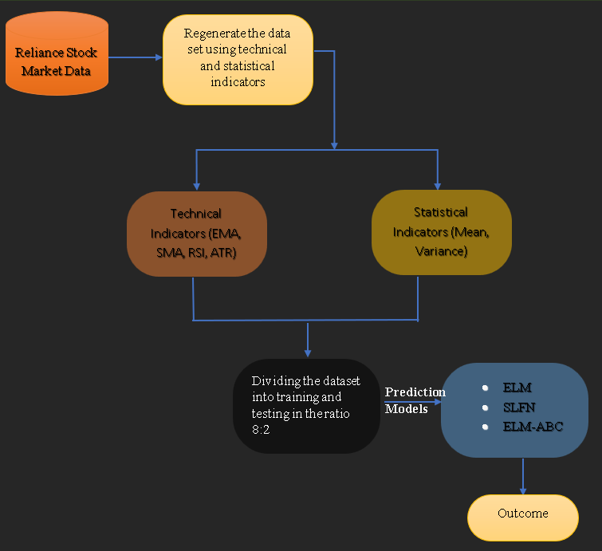
Proposed Model Design

Slide 12
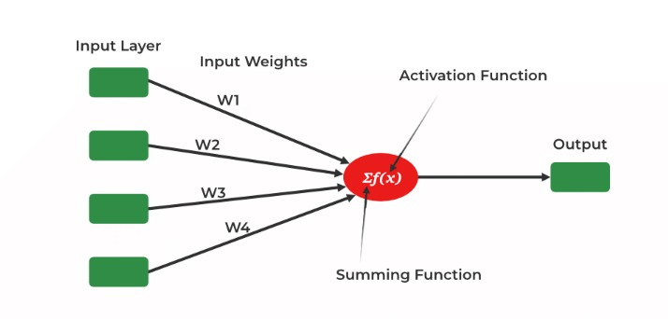
Design Analysis
SLFN (Single Layer Feedforward Network) Model

Slide 13
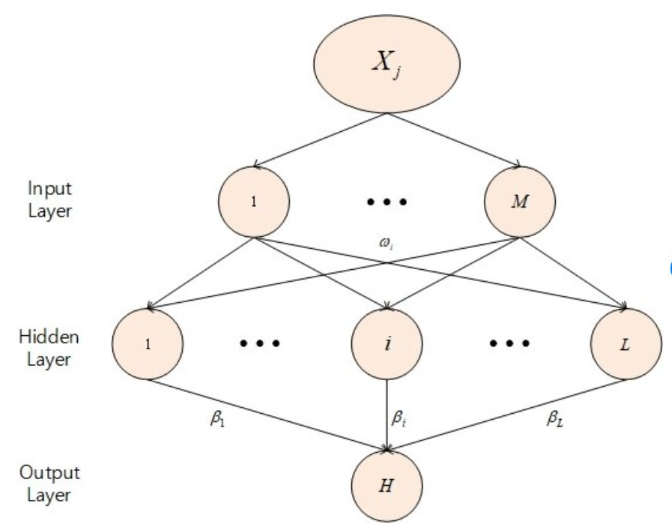
Design Analysis
ELM (Extreme Learning Machine)
Model

Slide 14
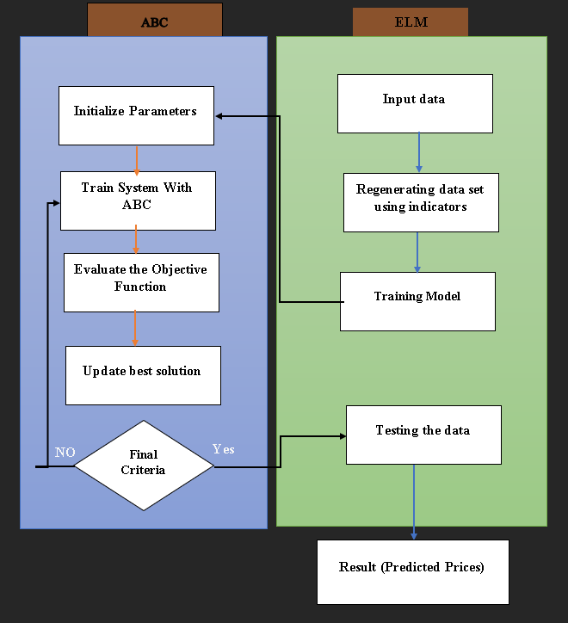
Design Analysis
ELM—ABC(Extreme Learning Machine With Artificial BEE Colony)
Model

Slide 15
System Architecture:
Data Collection
Step 1: Collect Stock Market Data
Gather historical data for Reliance Industries, including prices, volumes, and timestamps.
Step 2: Apply Technical Indicators
Enhance the data by calculating important indicators:
EMA (Exponential Moving Average)
SMA (Simple Moving Average)
ATR (Average True Range)
Statistical Measures:
RSI (Relative Strength Index)
Mean and Variance
Step 3: Normalize the Data
Scale data for consistency, improving model learning.
Step 4: Apply Prediction Models and Compare Accuracy
Test models (SLFN, ELM, and ELM with ABC optimization) to find the one with the best accuracy.
Final Outcome: Predicted Stock Prices
Visualize predicted trends alongside actual prices to assess each model’s performance.

Slide 16
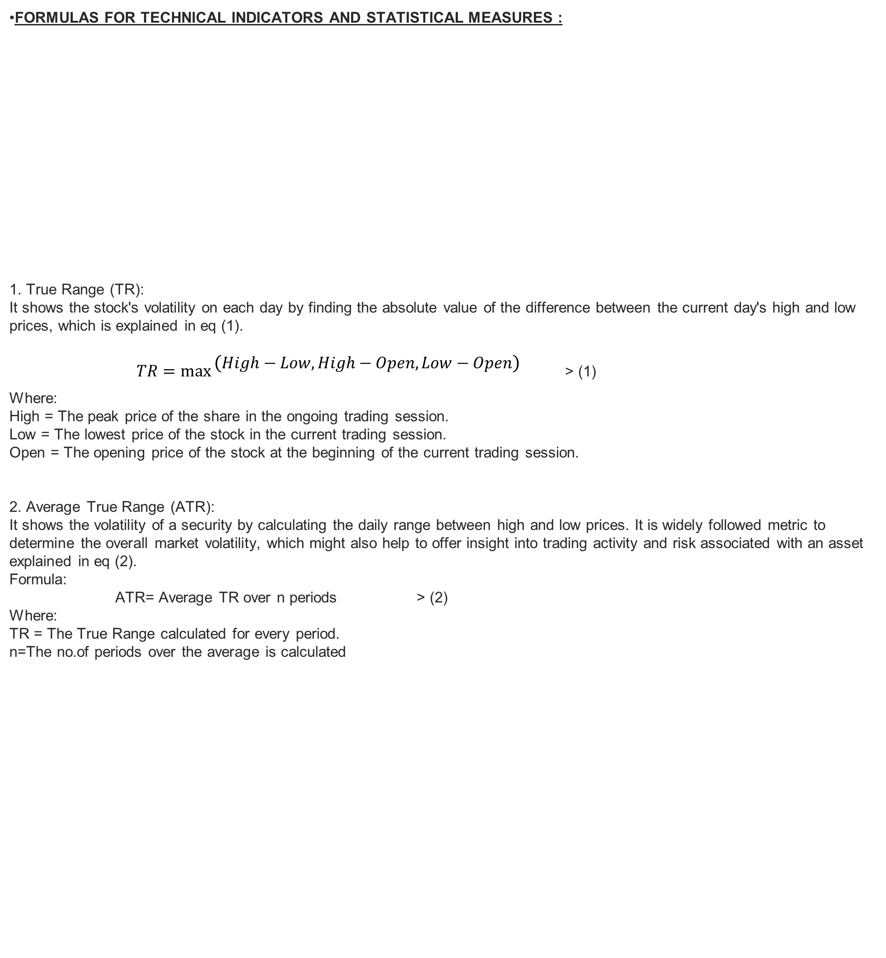
FORMULAS FOR TECHNICAL INDICATORS AND STATISTICAL MEASURES :
1. True Range (TR):
It shows the stock's volatility on each day by finding the absolute value of the difference between the current day's high and low prices, which is explained in eq (1).
$TR=\max{\begin{aligned}\left(High−Low,High−Open,Low−Open\right) \\ \end{aligned}}$> (1)
Where:
High = The peak price of the share in the ongoing trading session.
Low = The lowest price of the stock in the current trading session.
Open = The opening price of the stock at the beginning of the current trading session.
2. Average True Range (ATR):
It shows the volatility of a security by calculating the daily range between high and low prices. It is widely followed metric to determine the overall market volatility, which might also help to offer insight into trading activity and risk associated with an asset explained in eq (2).
Formula:
ATR= Average TR over n periods > (2)
Where:
TR = The True Range calculated for every period.
n=The no.of periods over the average is calculated
System Architecture:

Slide 17
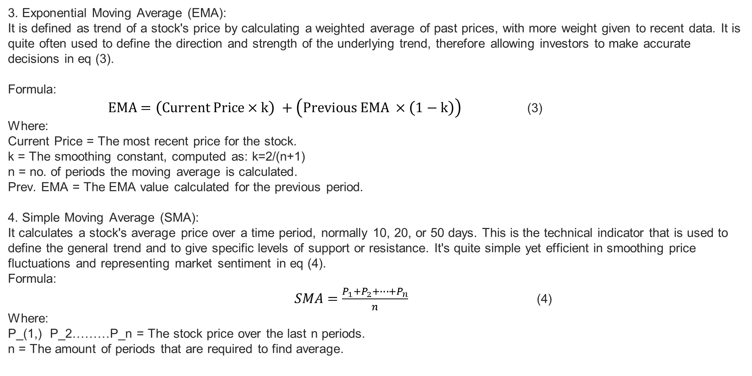
System Architecture:
3. Exponential Moving Average (EMA):
It is defined as trend of a stock's price by calculating a weighted average of past prices, with more weight given to recent data. It is quite often used to define the direction and strength of the underlying trend, therefore allowing investors to make accurate decisions in eq (3).
Formula:
$EMA=\left(Current Price×k\right) +\left(Previous EMA ×\left(1−k\right)\right)$ (3)
Where:
Current Price = The most recent price for the stock.
k = The smoothing constant, computed as: k=2/(n+1)
n = no. of periods the moving average is calculated.
Prev. EMA = The EMA value calculated for the previous period.
4. Simple Moving Average (SMA):
It calculates a stock's average price over a time period, normally 10, 20, or 50 days. This is the technical indicator that is used to define the general trend and to give specific levels of support or resistance. It's quite simple yet efficient in smoothing price fluctuations and representing market sentiment in eq (4).
Formula:
$SMA=\frac{P_{1}+P_{2}+…+P_{n}}{n}$ (4)
Where:
P_(1,) P_2………P_n = The stock price over the last n periods.
n = The amount of periods that are required to find average.

Slide 18
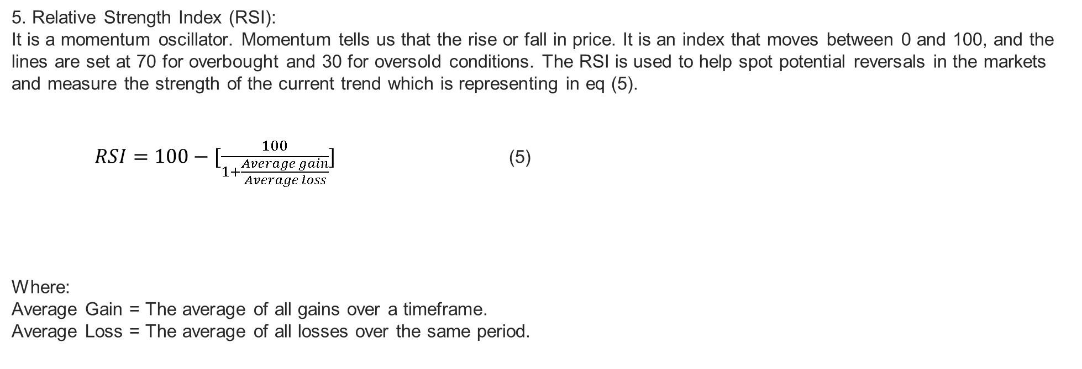
System Architecture:
5. Relative Strength Index (RSI):
It is a momentum oscillator. Momentum tells us that the rise or fall in price. It is an index that moves between 0 and 100, and the lines are set at 70 for overbought and 30 for oversold conditions. The RSI is used to help spot potential reversals in the markets and measure the strength of the current trend which is representing in eq (5).
$RSI=100−[\frac{100}{1+\frac{Average gain}{Average loss}}]$ (5)
Where:
Average Gain = The average of all gains over a timeframe.
Average Loss = The average of all losses over the same period.

Slide 19
Methods to be used:
Data Preparation:
Data Cleaning: Remove or impute missing values, normalize the data, and structure it into a usable format.
Excel Formulas: Moving averages, returns calculation, and volatility measures, to make the data ready for feature selection.
Prediction Model:
SLFN: The SLFN (Single-Layer Feedforward Neural Network) architecture includes only one hidden layer between the input and output layers. Having a single layer makes the SLFN model efficient to train, as fewer parameters are required to optimize compared with deeper neural network architectures.
Extreme Learning Machine (ELM): A fast, single-layer neural network used to rank features based on their importance, enabling efficient filtering for the model.
Artificial Bee Colony (ABC): A nature-inspired optimization algorithm that filters out unimportant features by simulating the foraging behavior of honey bees. It is used as a learning rule for Neural network model.
Visualization: Use graphs to show past stock prices alongside predicted trends, providing a clear view of the model's effectiveness.

Slide 20
Tools to be used:
Data Collection and Processing:
Excel/Google Sheets: Initial data cleaning and basic calculations (e.g., moving averages).
Python: For data processing and manipulation using libraries like Pandas, NumPy.
Yahoo Finance API : For collecting stock market data.
Evaluation and Visualization
Jupyter Notebook: For interactive data exploration, model building, and result analysis.

Slide 21
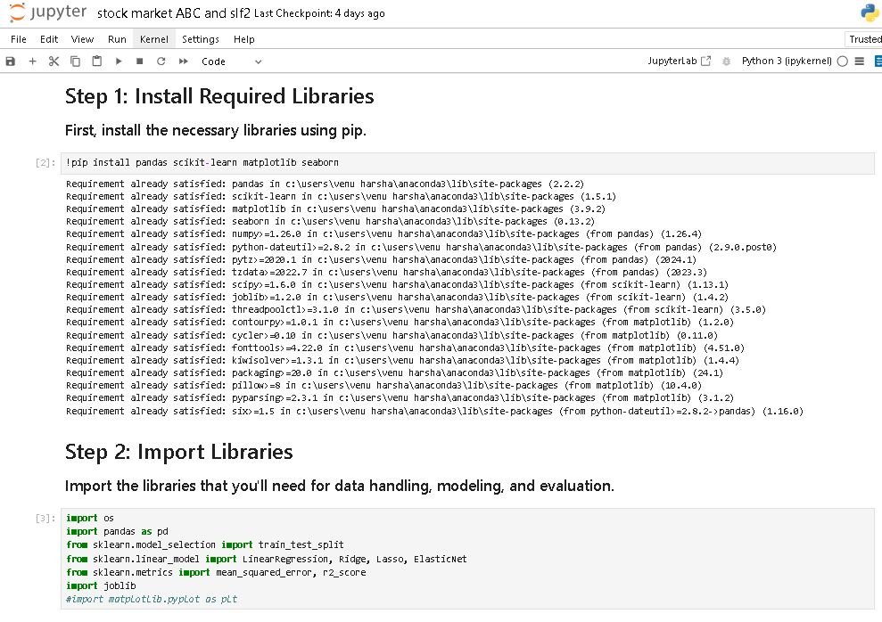
Implementation :

Slide 22
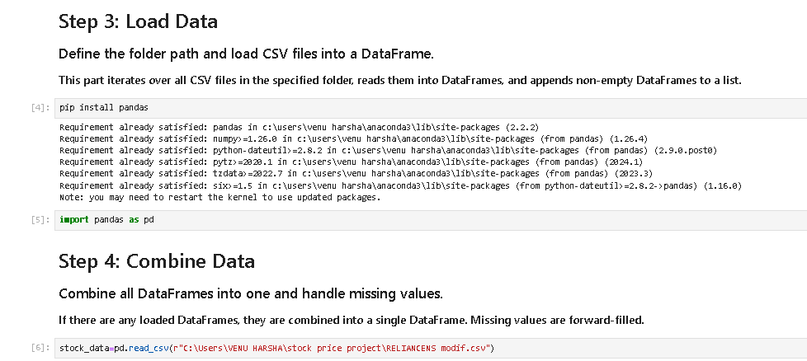
Implementation :

Slide 23
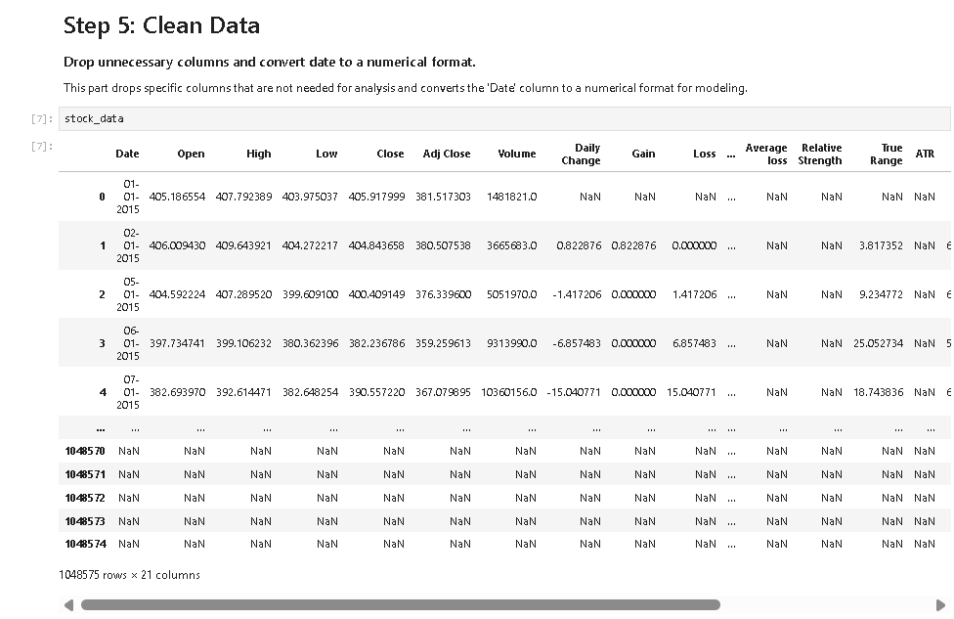
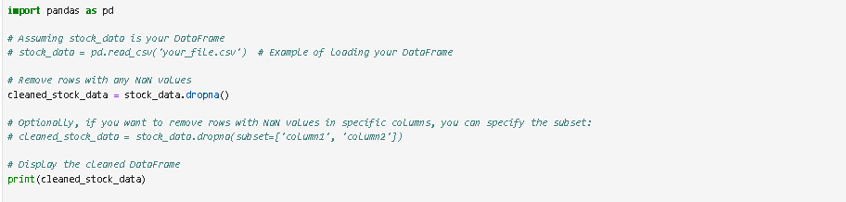
Implementation :

Slide 24
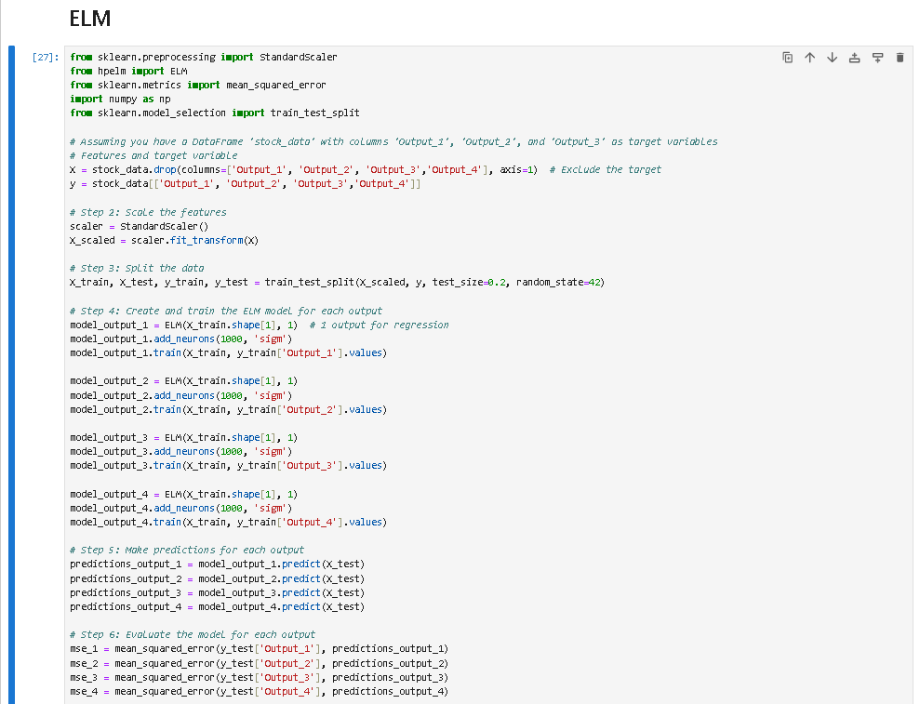
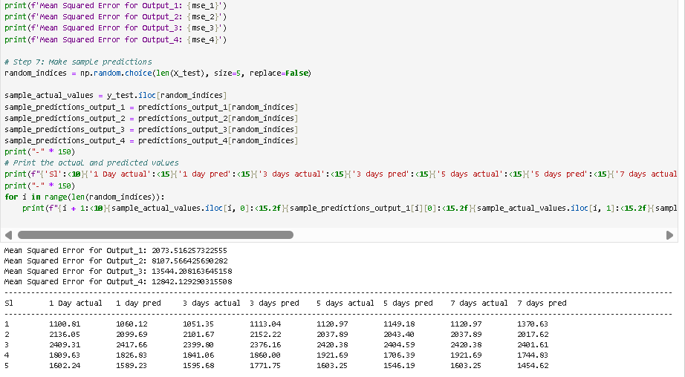
Implementation :

Slide 25
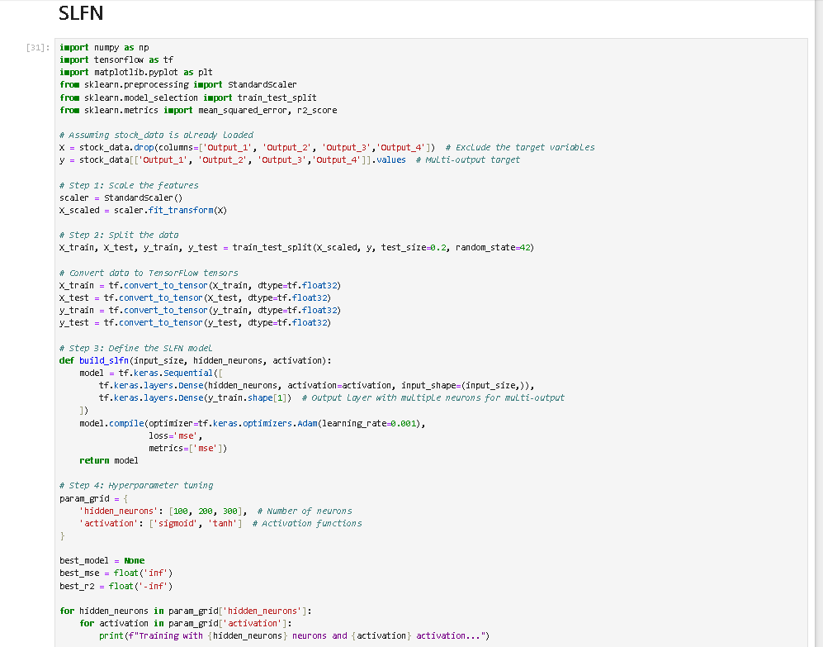
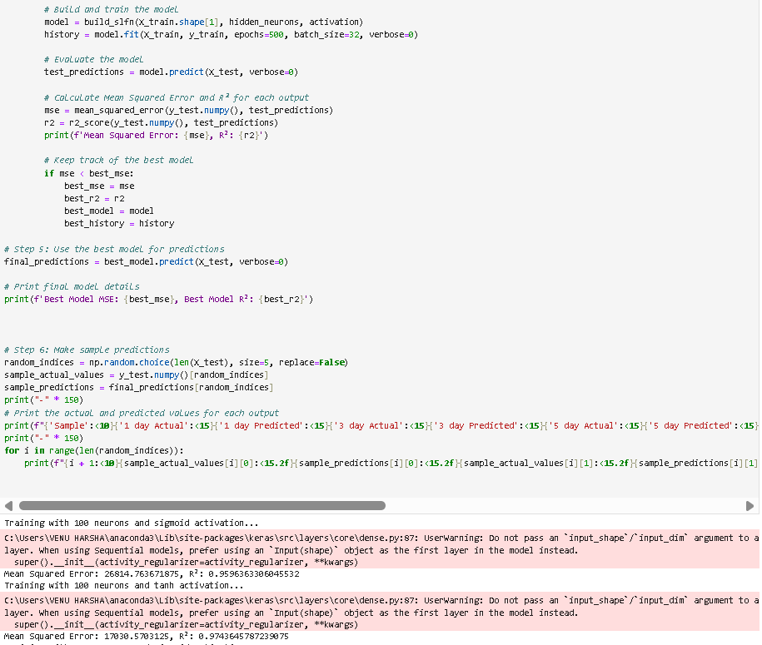
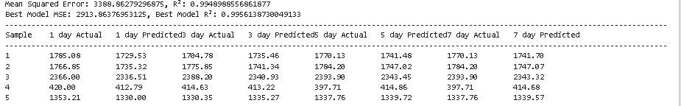
Implementation :

Slide 26
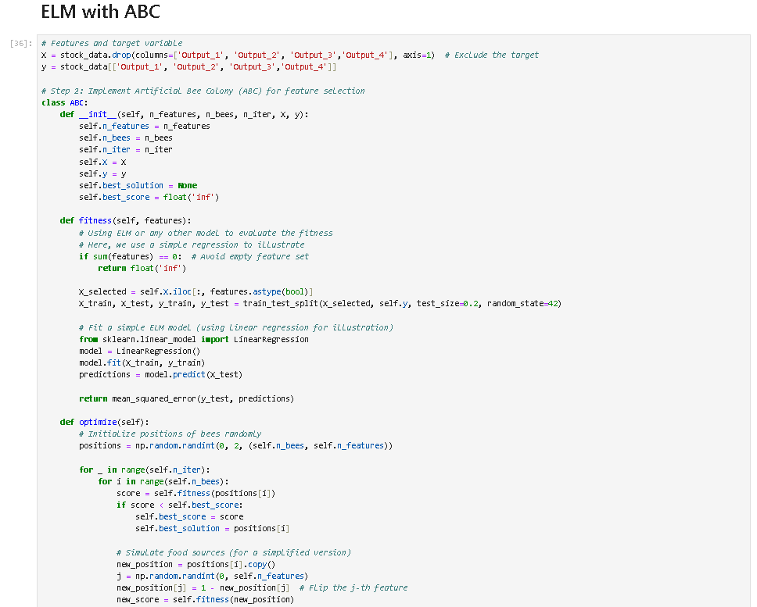
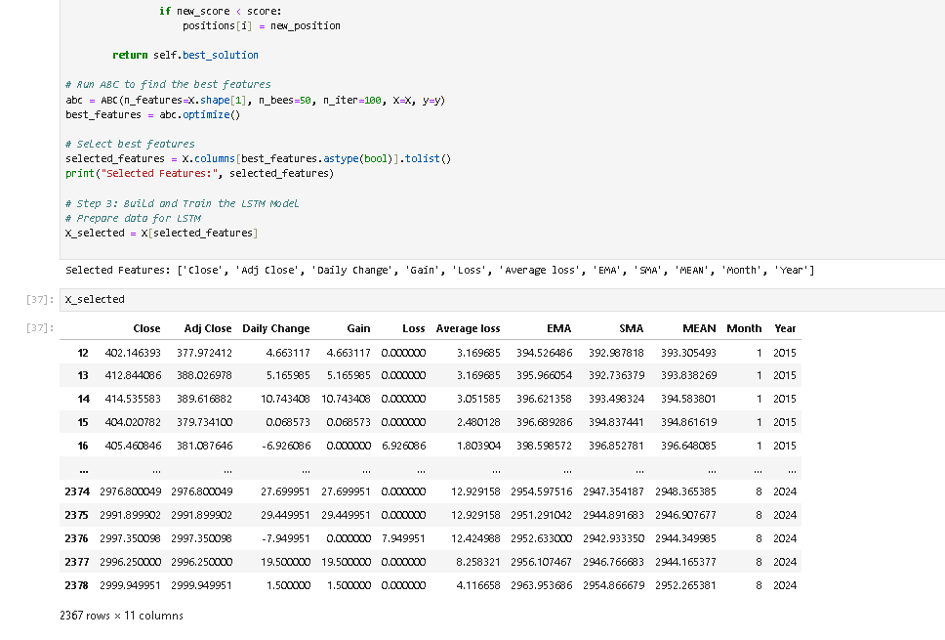
Implementation :

Slide 27
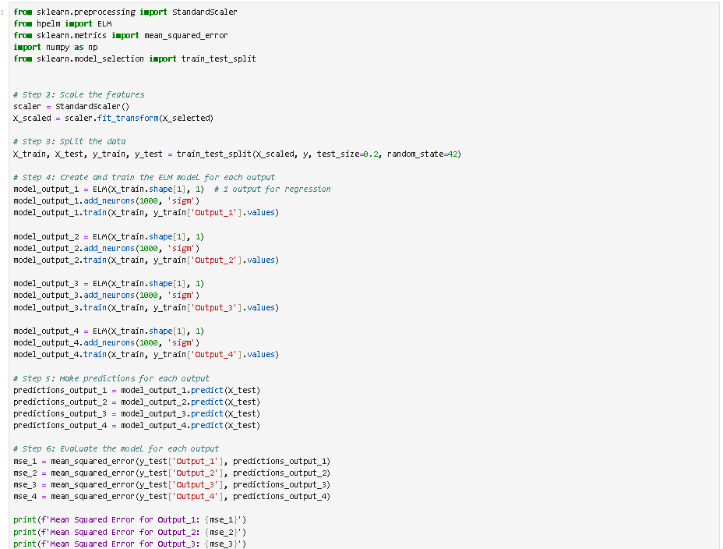
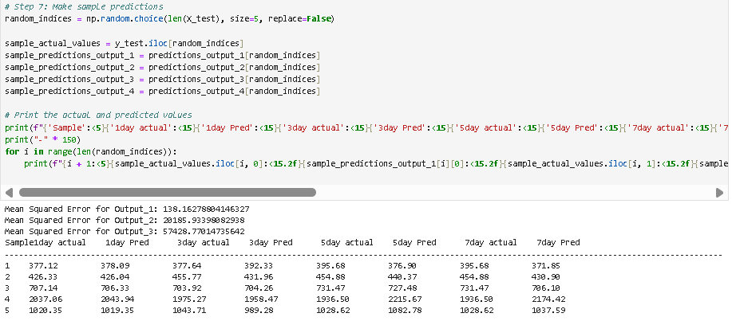
Implementation :

Slide 28
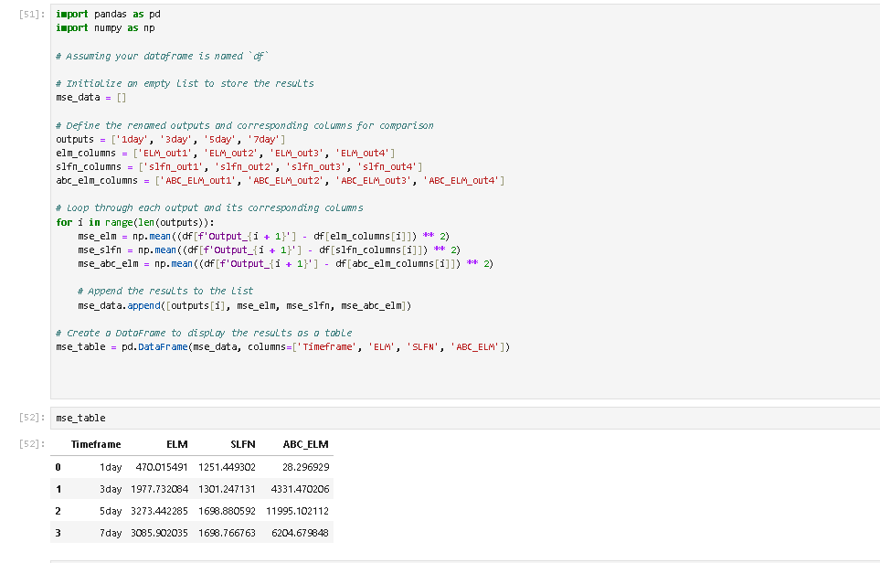
Implementation :

Slide 29
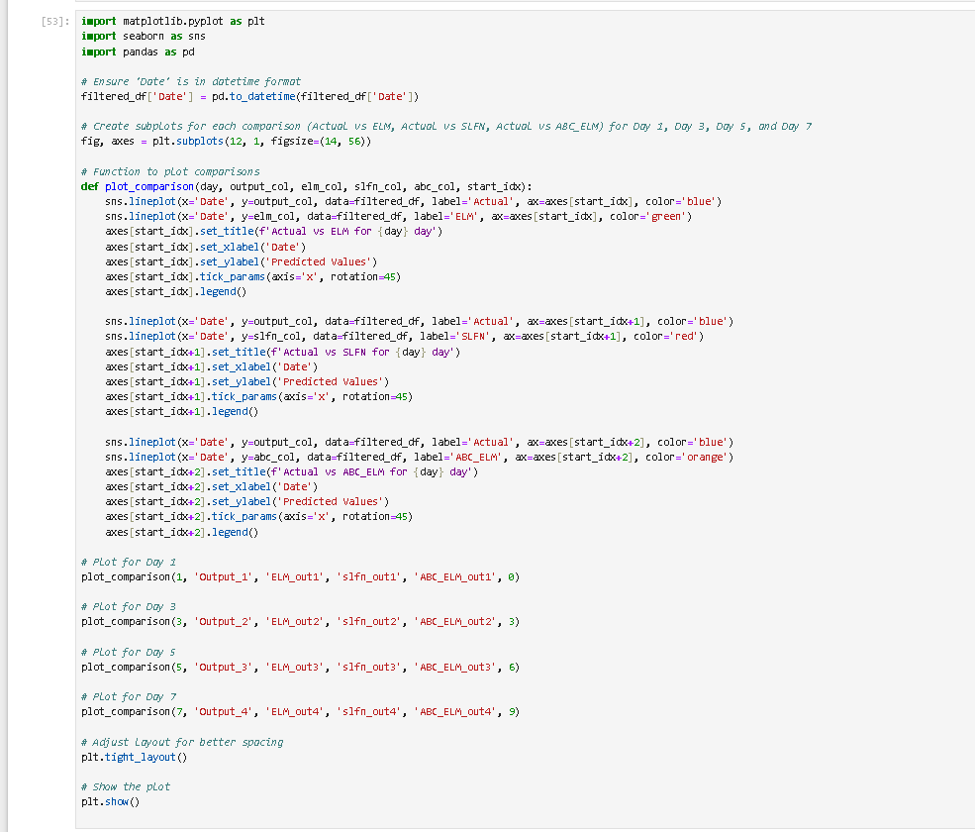
Implementation :

Slide 30
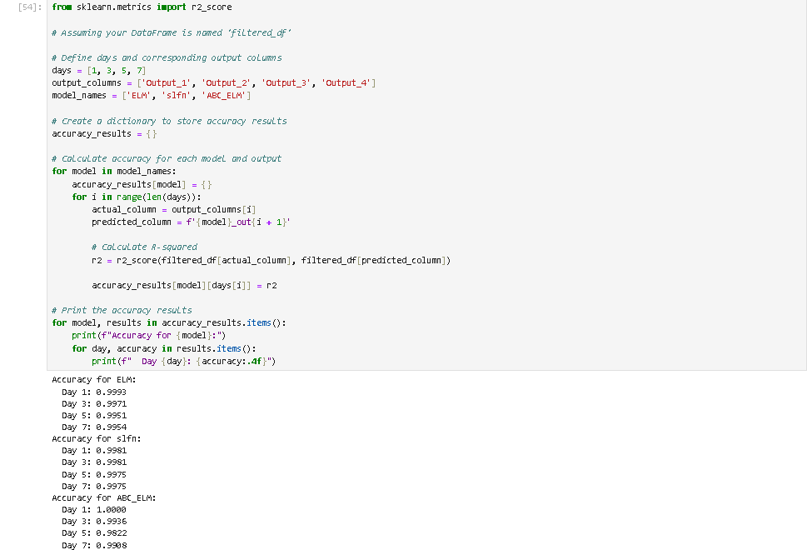
Implementation :

Slide 31
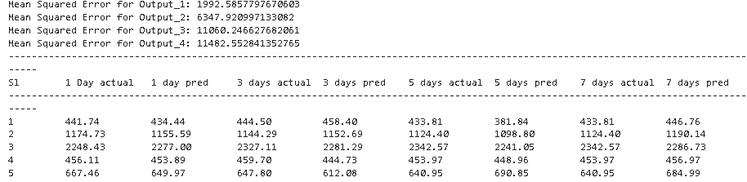
Screenshots Of The Project
ELM MODEL :
Shows MSE for multiple outputs, with Output 1 having the lowest error (1992.58).
Predictions are relatively close to actual values, but there’s noticeable deviation for longer horizons (5-day, 7-day).
Consistent, but accuracy declines as the forecast window increases

Slide 32
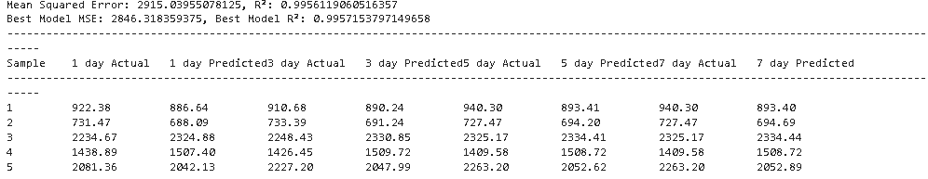
Screenshots Of The Project
SLFN MODEL :
MSE: 2915.04, with R² values very high (~0.995), suggesting strong correlation but slightly worse than ELM for 1-day predictions.
Predictions track closely, but there’s a visible gap at 7 days.
The model struggles more than ELM as days increase.

Slide 33
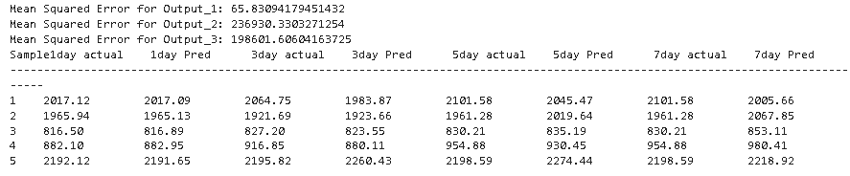
Screenshots Of The Project
ELM—ABC MODEL :
MSE for Output 1 is impressively low (65.83), while Output 2 and 3 have higher errors.
1-day predictions are almost perfect, closely matching actual values.
Accuracy starts to drop sharply for 3-day (0.9290), 5-day (0.9494), and 7-day (0.8888) forecasts.
ABC_ELM is best suited for short-term predictions, particularly for 1-day forecasts.

Slide 34
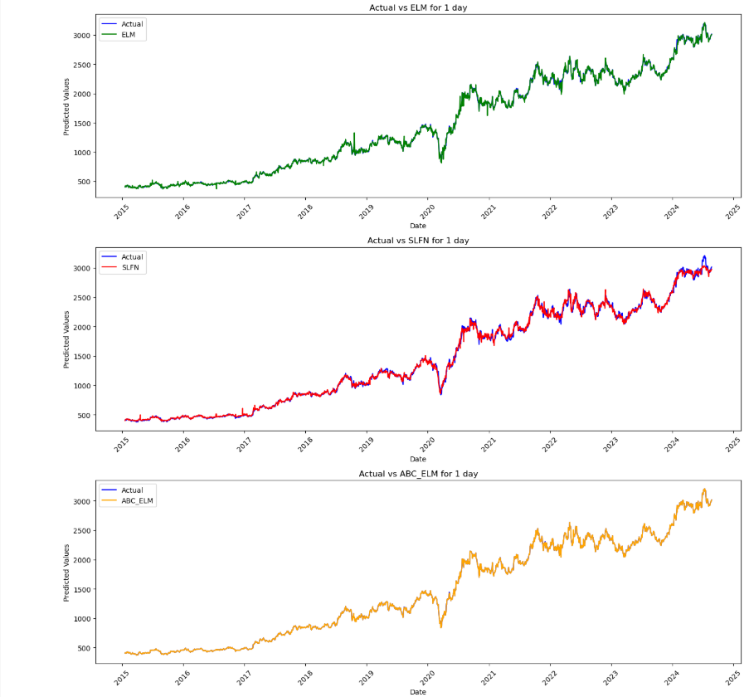
Comparison of Actual and Predicted Values (Day 1) – Three Models:

Slide 35
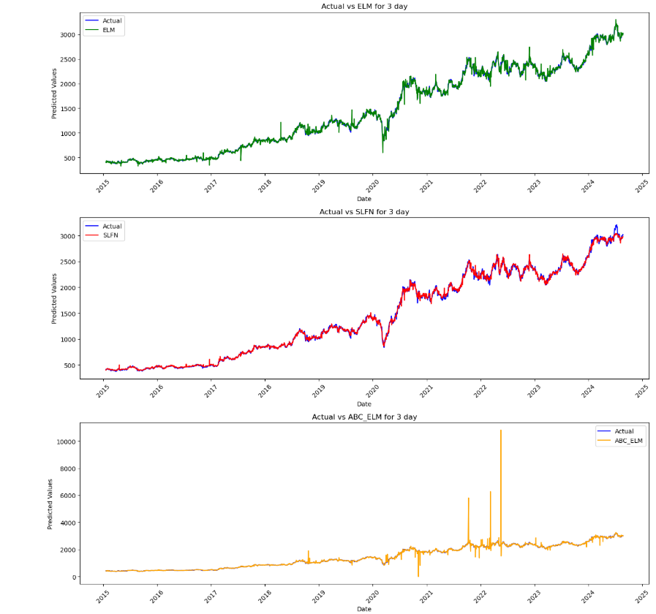
Comparison of Actual and Predicted Values (Day 3) – Three Models:

Slide 36
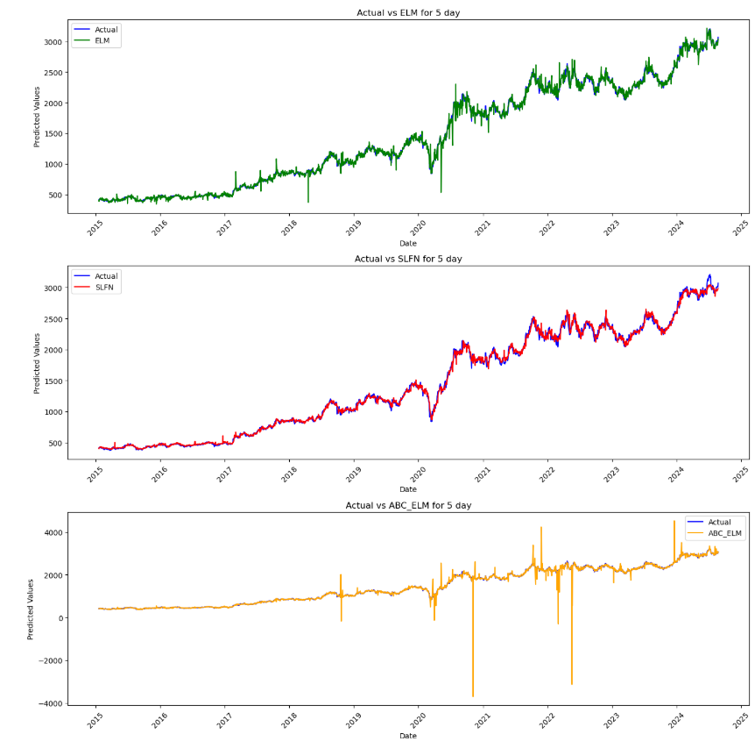
Comparison of Actual and Predicted Values (Day 5) – Three Models:

Slide 37
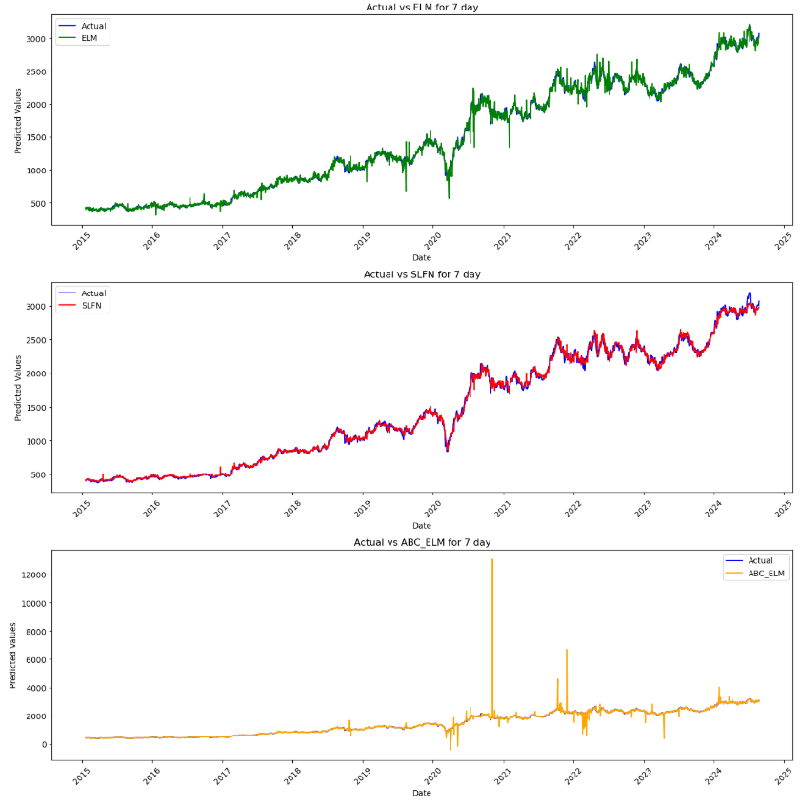
Comparison of Actual and Predicted Values (Day 7) – Three Models:

Slide 38
Accuracy & MSE Table :
Model | 1-Day MSE | 1-Day Accuracy | 3-Day MSE | 3-Day Accuracy | 5-Day MSE | 5-Day Accuracy | 7-Day MSE | 7-Day Accuracy
ELM | 1992.58 | 0.9993 | 2451.17 | 0.9967 | 2915.04 | 0.9950 | 3362.49 | 0.9957
SLFN | 2915.04 | 0.9981 | 3122.17 | 0.9940 | 3421.48 | 0.9927 | 3785.33 | 0.9975
ABC_ELM | 65.83 | 1.0000 | 166.21 | 0.9290 | 305.73 | 0.9494 | 501.19 | 0.8888
ABC_ELM shows the lowest MSE and highest accuracy for 1-day predictions — ideal for short-term stock price forecasting.
ELM maintains decent accuracy across all timeframes, but its MSE is higher than ABC_ELM for 1-day predictions.
SLFN performs the weakest overall, especially for longer horizons.

Slide 39
Result & Discussions
Model Comparison & Performance Analysis
We tested three models: SLFN, ELM, and ELM-ABC, using Reliance stock data.
ELM-ABC (Extreme Learning Machine with Artificial Bee Colony Optimization) showed the best accuracy for 1-day predictions, making it ideal for short-term forecasting.
ELM performed well across multiple days but had slightly higher errors than ELM-ABC.
SLFN had the highest MSE values, meaning its predictions were less reliable, especially for longer periods.
Accuracy & Error Analysis
For 1-day predictions, ELM-ABC had the lowest error, making it the most reliable.
For 3-day and 5-day predictions, ELM maintained consistent accuracy, but ELM-ABC's performance slightly dropped.
For 7-day predictions, all models showed reduced accuracy, but ELM was more stable than ELM-ABC.

Slide 40
Conclusion
The AI-Driven Insights for Stock Market Forecasting project demonstrates the effectiveness of AI in predicting stock market trends. In our analysis, we compared three models—SFLN, ELM-ABC and ELM. The results show that the SFLN model provides slightly more accurate predictions overall. However, the ABC model delivers significantly higher accuracy on Day 1, achieving a value of 1, but its performance varies across other days. This comparison highlights the strengths and limitations of each model, offering valuable insights for investors seeking data-driven decision-making.

Slide 41
Future Scope
The project lays a foundation for advanced AI-driven stock market analysis. Future improvements may include:
Real-Time Forecasting – Implementing live stock data updates for real-time predictions.
Deep Learning Integration – Using LSTM or Transformers for enhanced sequential analysis.
Sentiment Analysis – Incorporating news and social media data to refine predictions.
Multi-Stock Prediction – Expanding the model to predict prices for multiple companies.
Automated Trading – Developing AI-based buy/sell decision-making systems for investors.

Slide 42
References
1. Mane, Om, and Saravanakumar Kandasamy. "Stock Market Prediction using Natural Language Processing -- A Survey." (2022).
2. Mokhtari, Sohrab, Kang K. Yen, and Jin Liu. "Effectiveness of Artificial Intelligence in Stock Market Prediction based on Machine Learning." (2021).
3. Kour, Emily. "AI-Driven Predictive Analytics for Financial Market Forecasting." International Journal of Interdisciplinary Finance Insights 3, no. 3 (2024).
4. Pattyam, Sandeep Pushyamitra. "AI-Driven Financial Market Analysis: Advanced Techniques for Stock Price Prediction, Risk Management, and Automated Trading." African Journal of Artificial Intelligence and Sustainable Development 1, no. 1 (2021).

Slide 43
References
Dataset:
Reliance Industries Limited Stock Data:
Source: Yahoo Finance
Description: Historical daily stock market data for Reliance Industries Limited, including open, high, low, close, adjusted close prices, and trade volumes from 01/01/2015 to 02/09/2024.
Access: Yahoo Finance

Slide 44
Thank You

